Slide 1


Slide 2
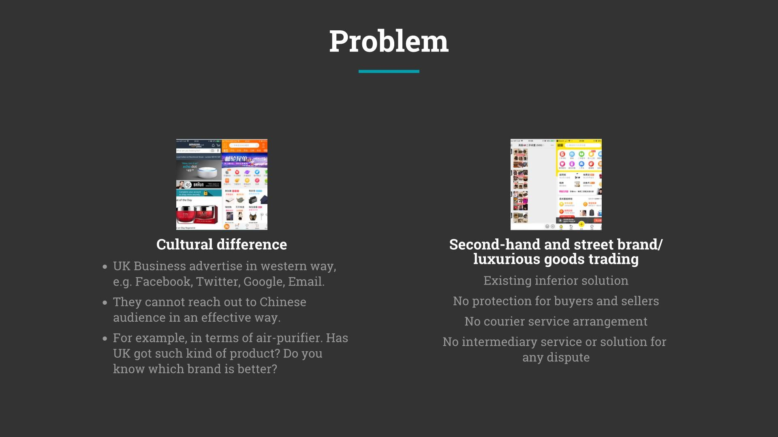

Slide 3
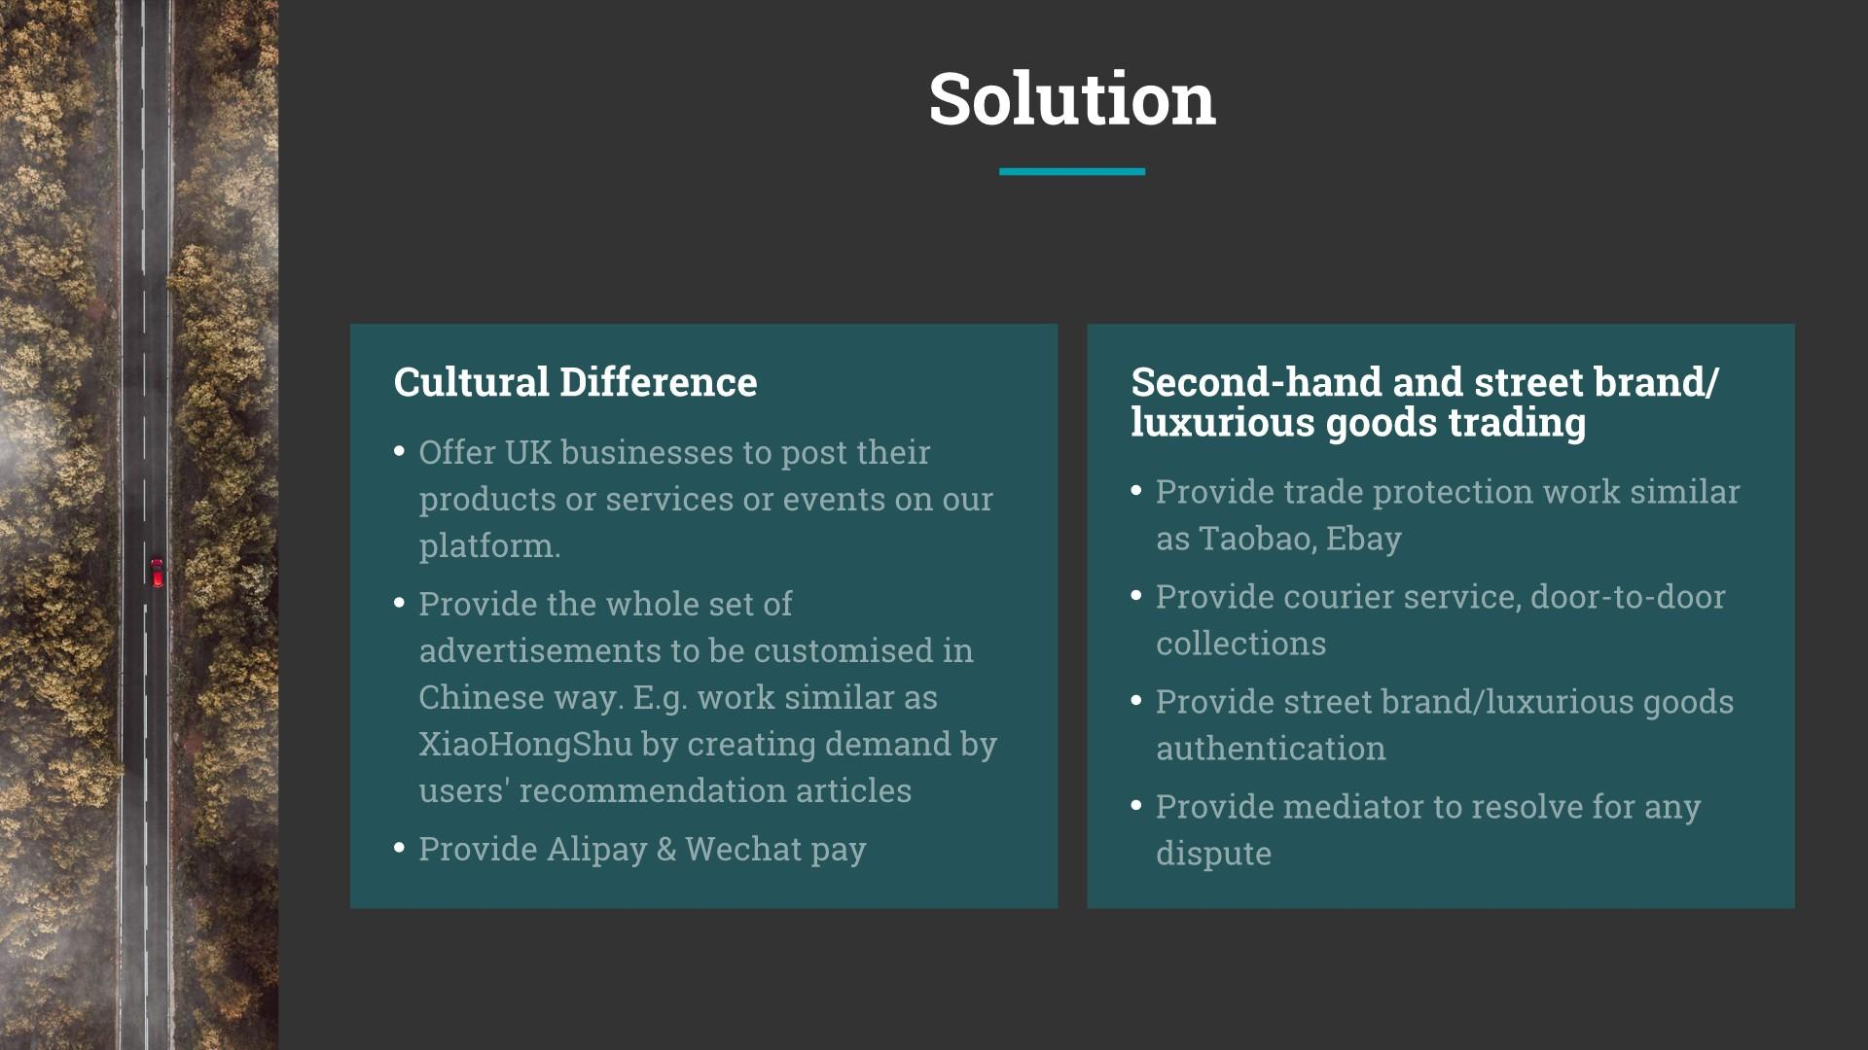

Slide 4
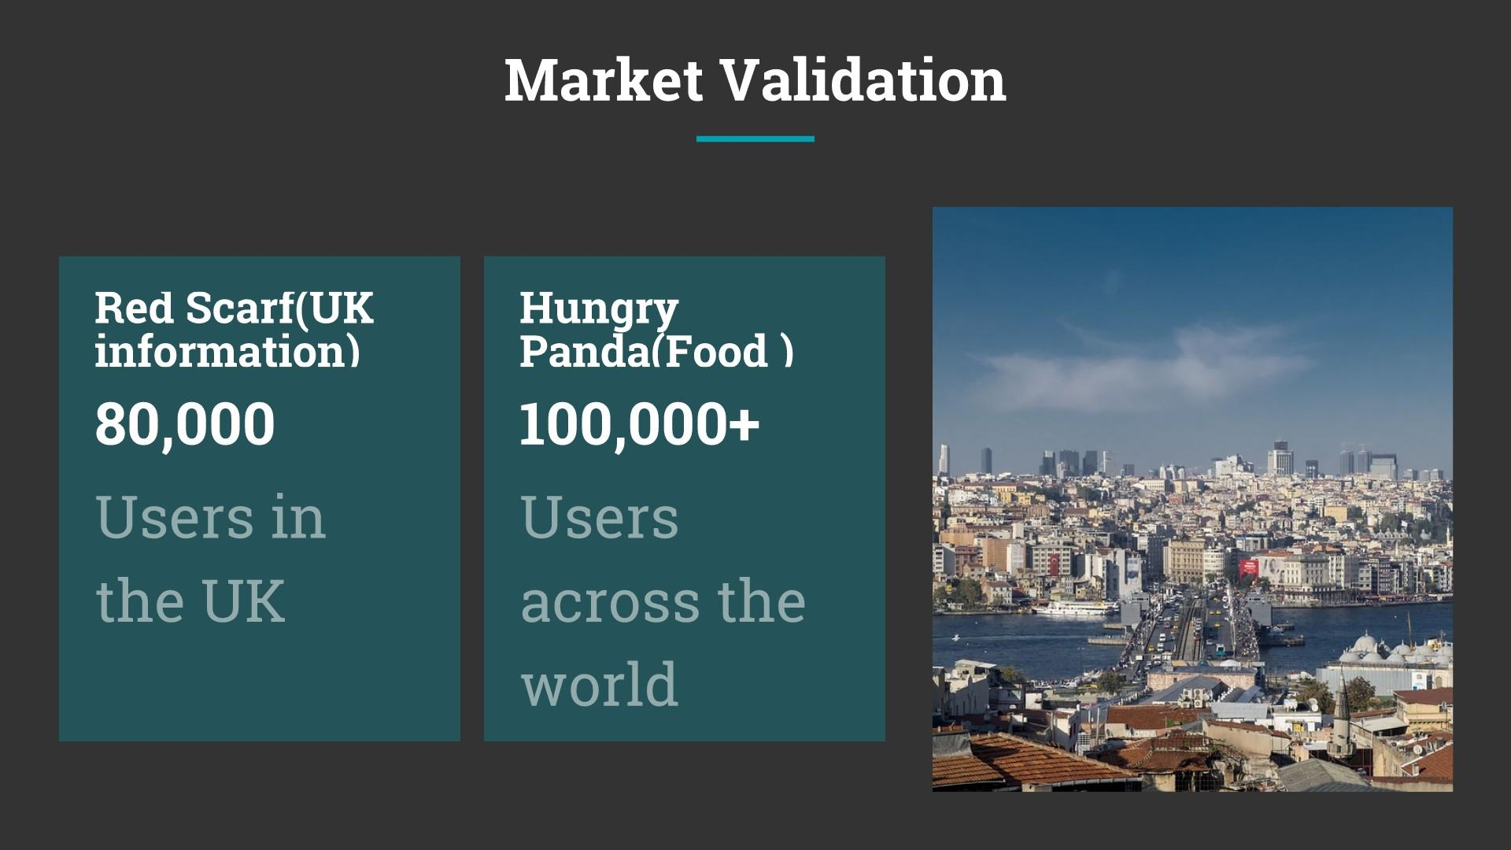

Slide 5
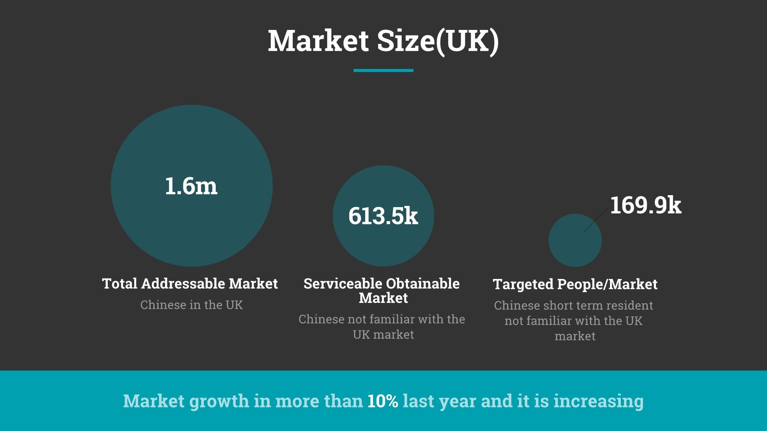

Slide 6
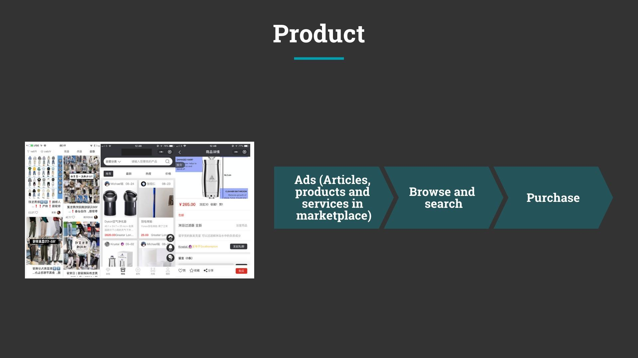

Slide 7
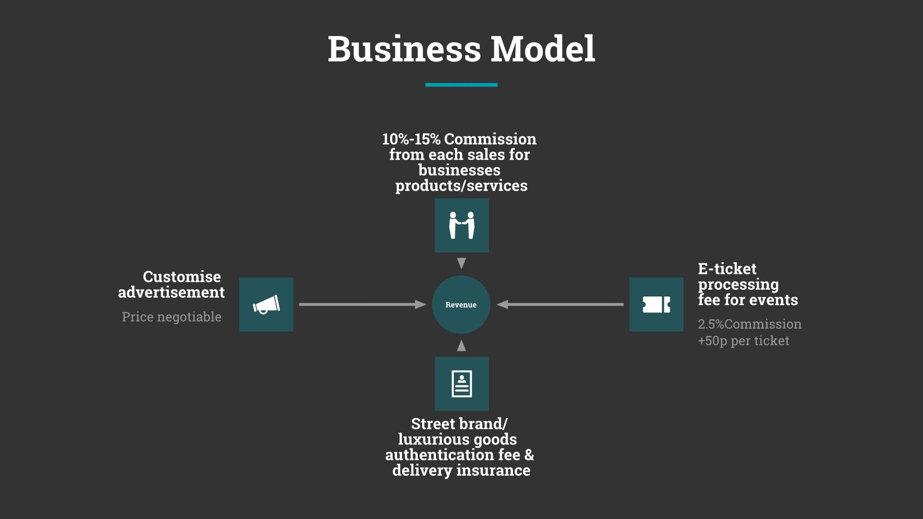

Slide 8




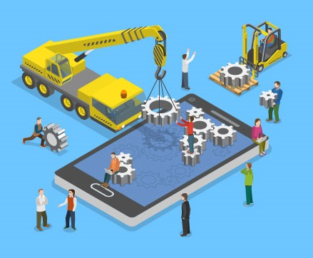




Technology Stack

Slide 9
Technology Stack
Notes:
For our technology stack, there are mainly two parts which are under development – the core shopping functionality and a recommendation system.

Slide 10
Technology Stack
Notes:
The core functionality is being built with React at the frontend and Firebase for Backend (as a Service).
Node.js and Python are used for cloud functions on Firebase.
The machine learning part, on the other hand, involves mainly Python and common libraries such as TensorFlow, Numpy, Scipy.
This will then be deployed in containers to kubernetes clusters on Google Cloud engine.

Slide 11
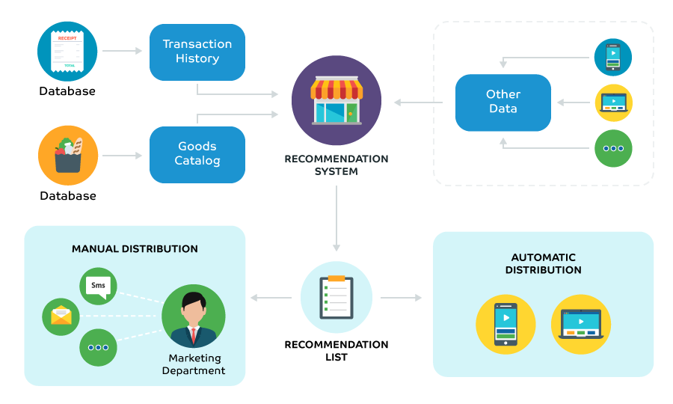
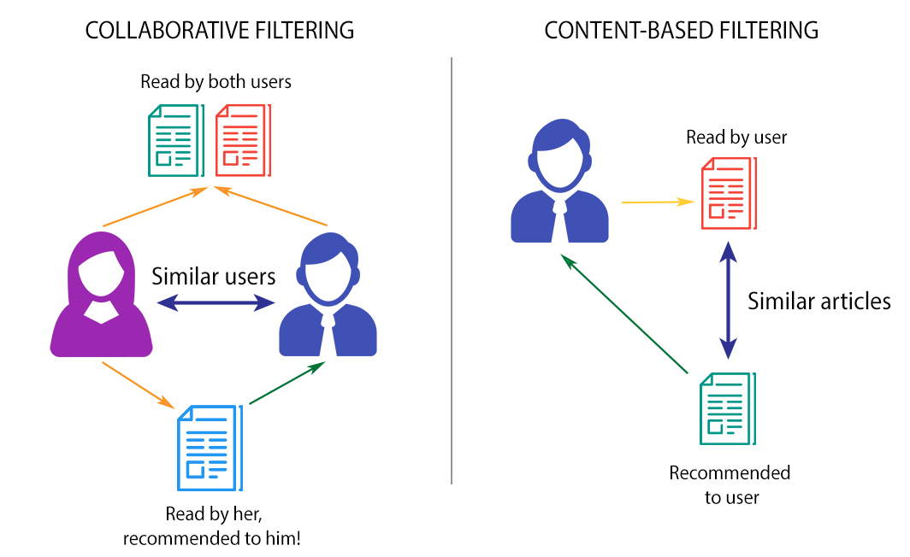
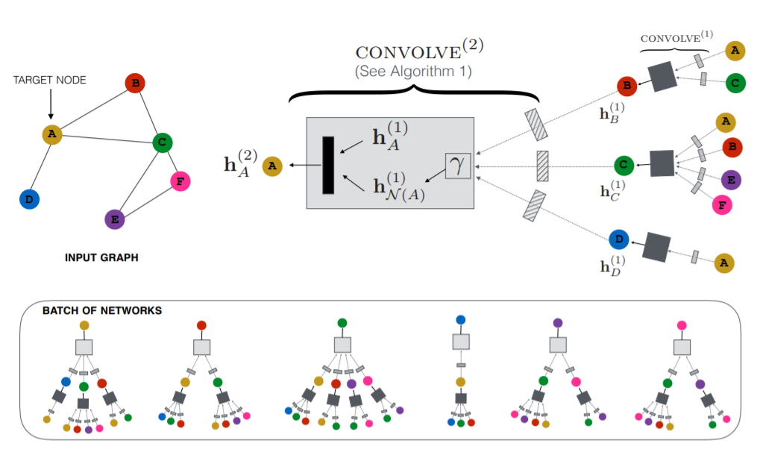
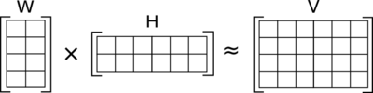

Artificial Intelligence
Graph Convolutional Neural Networks
Non-negative Matrix Factorisation
Notes:
CONVOLVE: https://arxiv.org/pdf/1806.01973.pdf

Slide 12
Artificial Intelligence
Notes:
Taking a more detailed view on our recommendation system, here is a brief introduction on how it will work.
We receive transaction history, goods catalog and user usage data from other interfaces of our app.
These data will then be passed to our recommendation system and a list of recommendations will be produced for the customers.
The list can then be distributed through various channels, such as feeds in the app or recommended goods.

Slide 13
Artificial Intelligence
Notes:
In terms of algorithm, we will start by looking at collaborative filtering and content-based filtering, especially for small datasets in the beginning,

Slide 14
Artificial Intelligence
Graph Convolutional Neural Networks
Notes:
CONVOLVE: https://arxiv.org/pdf/1806.01973.pdf Once, the usage increases and more data get collected, we will consider a neural network based method to boost performance.

Slide 15
Artificial Intelligence
Non-negative Matrix Factorisation
Notes:
We will also consider a more novel, matrix factorization based method, which was proposed by Jason.

Slide 16
Artificial Intelligence
Notes:
CONVOLVE: https://arxiv.org/pdf/1806.01973.pdf

Slide 17
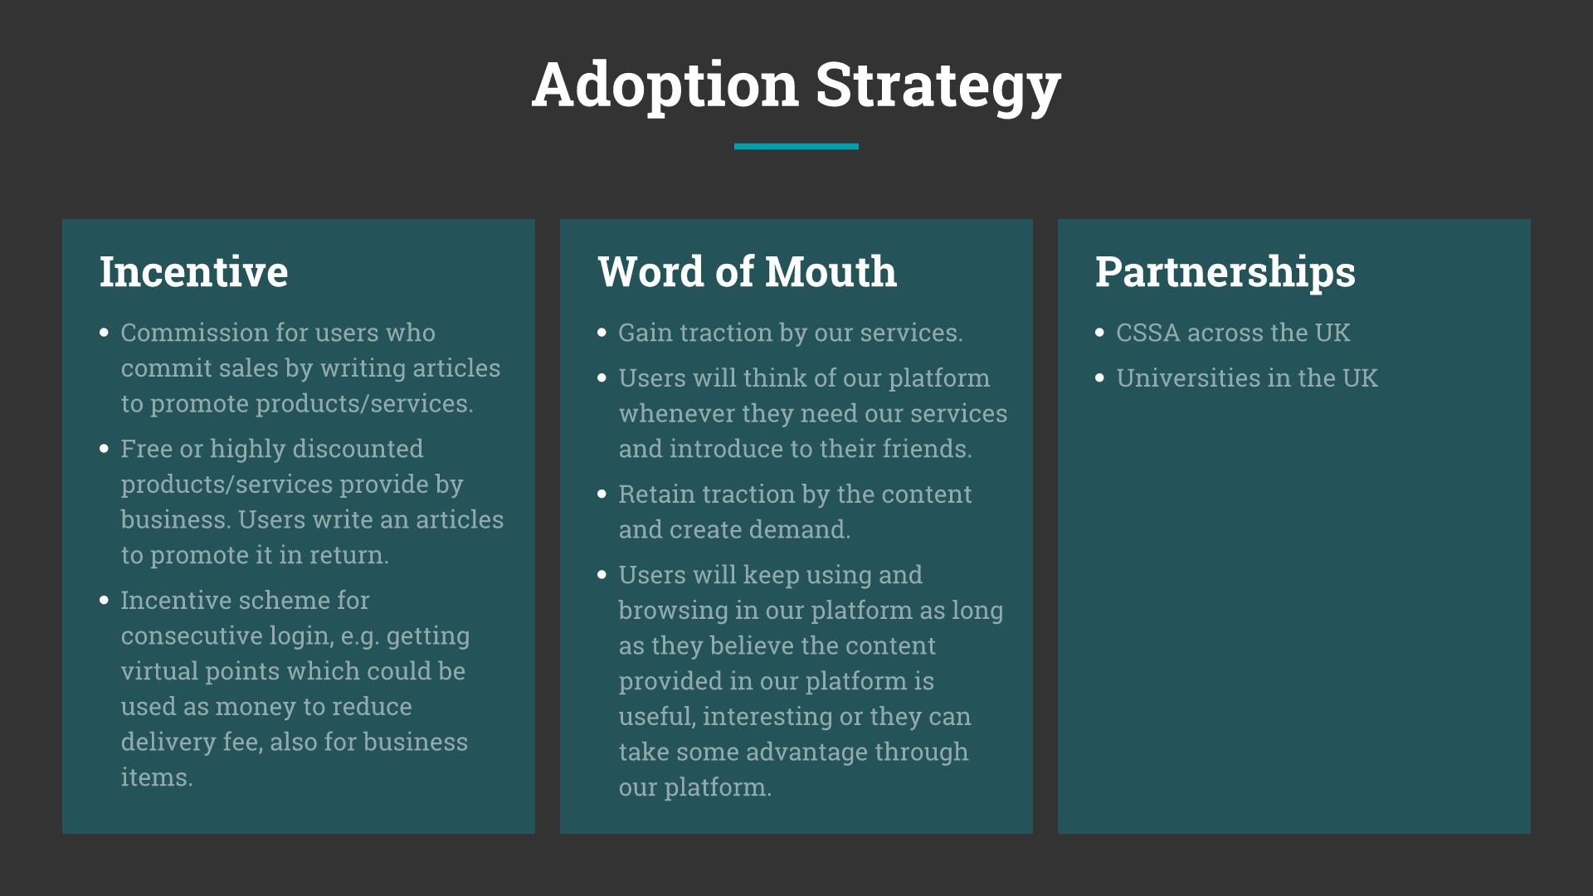





Slide 18
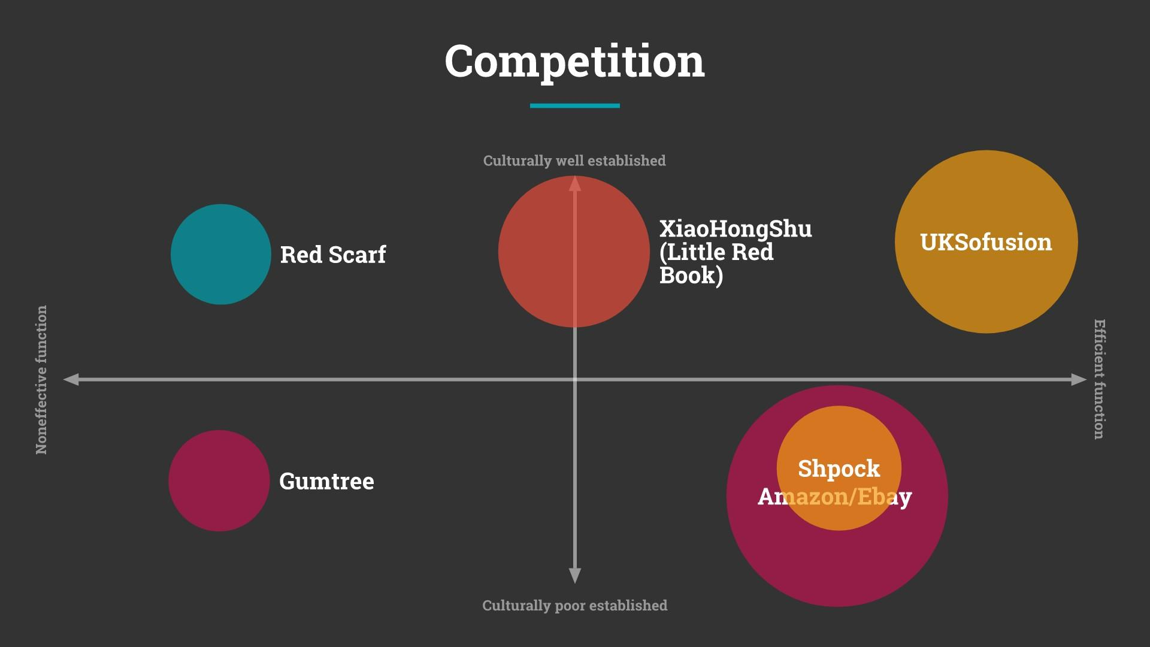

Slide 19
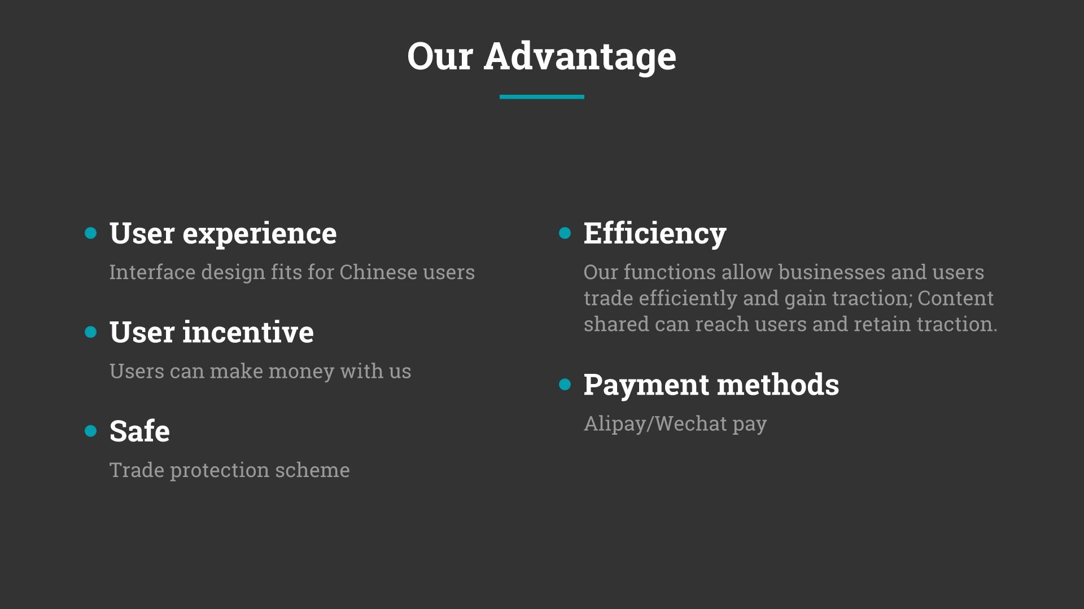

Slide 20
